Slide 1



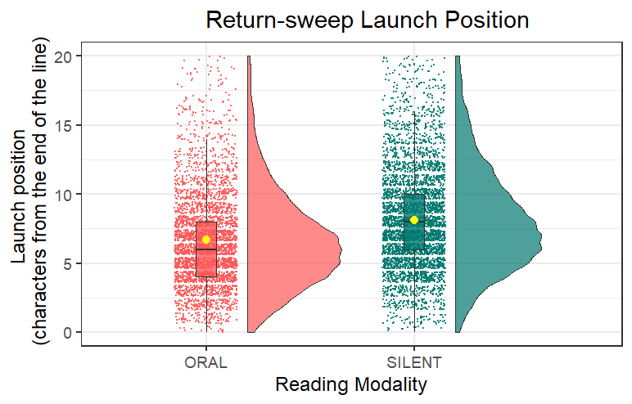
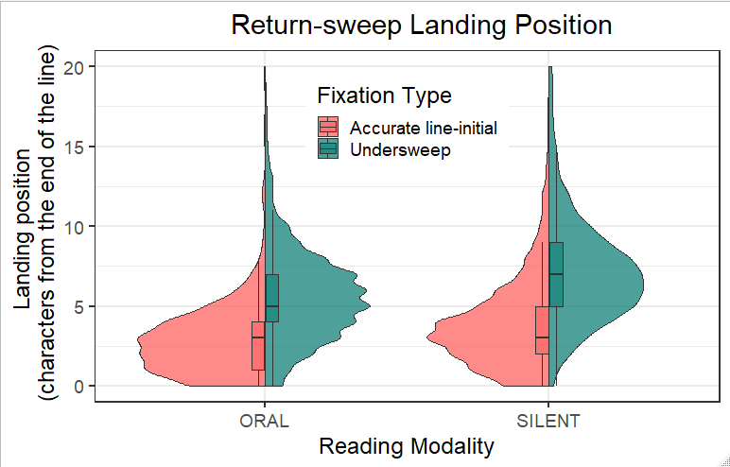

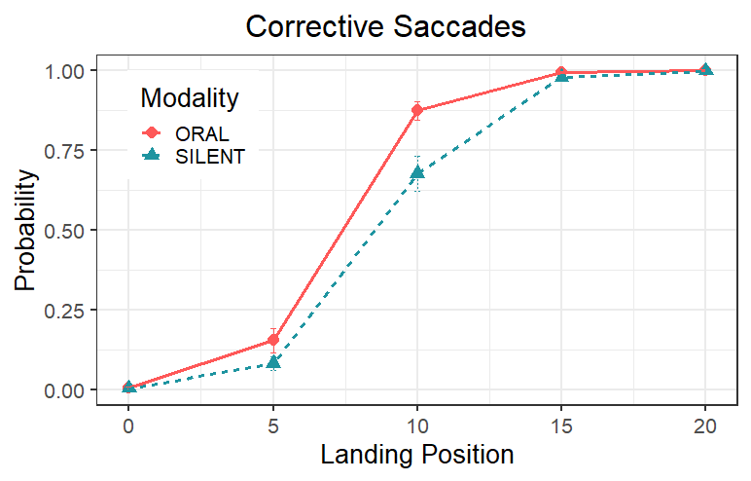
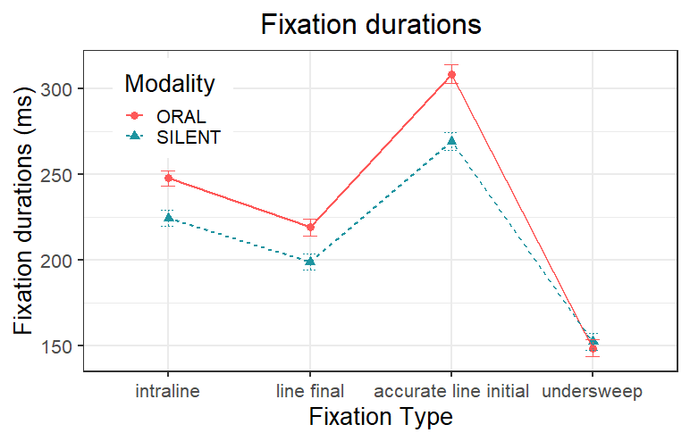
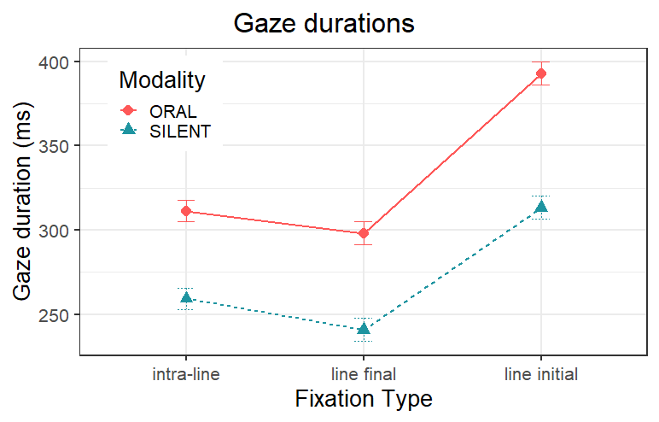




Return-sweep saccades in oral and silent reading Victoria Adedeji ¹|Adam Parker ²| Julie Kirkby ¹|Tim Slattery¹ ¹ Bournemouth University ² University of Oxford
Return-sweeps may offer a natural pause in the uptake of new visual information which readers can use to prevent the eyes from getting too far ahead of the voice during oral reading.
Background
Method
Return-sweep saccades take reading fixations from the end of one line of text to the beginning of the next[3].
During silent reading, the fixation prior to a return-sweep is shorter in duration than intra-line fixations while accurate line-initial fixations are longer[3].
Design
Secondary data analysis of a 2 by 2 experimental study
Participants
23 students from Bournemouth University participated
Materials
40 multiline text.
(mean number of lines= 11)
Apparatus
Cambridge Research Systems 32’ Display++ LCD monitor
Apparatus
SR Research Eye Link 1000 sampling
at 1000 Hz
Data Analysis (G)LMMs were used to analyse the data
Fixation durations and refixation rates increase while parafoveal preview benefit significantly reduces for oral compared to silent reading[1].
Results
The eyes often lead the voice[2] during oral reading and this coupling may impact return-sweep planning and execution.
Are there differences in return-sweep programming in oral and silent reading ?
Return-sweeps were launched from closer to the end of a line and landed closer to the beginning of the subsequent line during oral reading compared to silent reading.
The probability of making a corrective saccade increased for reading aloud if landing position was less than 15 characters from margin.
The time cost associated with oral reading was significantly greater for accurate line-initial fixation durations, line-final and accurate line-initial gaze durations in comparison to intra-line fixation and gaze durations respectively.
Conclusion
The cost associated with reading out loud is greater when moving between lines than moving within a line.
Additional fixations at the end of the line
may be due to line-final wrap up effects that occur because readers need to integrate information at that point before proceeding to take a longer pause at the start of the new line.
References
Thanks to
[1] Ashby, J., Yang, J., Evans, K. H. C., & Rayner, K. (2012). Eye movements and the perceptual span in silent and oral reading. Attention, Perception, and Psychophysics, 74, 634–640. https://doi.org/10.3758/s13414-012-0277-0
[2] Laubrock, J., & Kliegl, R. (2015). The eye-voice span during reading aloud. Frontiers in Psychology, 6, 1–19. https://doi.org/10.3389/fpsyg.2015.01432
[3] Parker, A. J., Slattery, T. J., & Kirkby, J. A. (2019). Return-sweep saccades during reading in adults and children. Vision Research, 155, 35–43. https://doi.org/10.1016/j.visres.2018.12.007
Contact
vadedeji@bournemouth.ac.uk
@ibidunniadedeji

